Slide 1
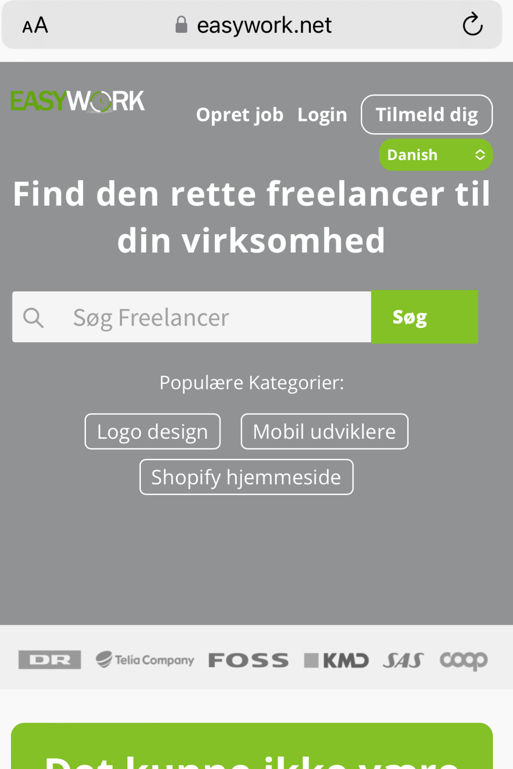
This power point is only for Mobile version
Please remove the line around Tilmeld dig
Align the text and logo
The box where we can choose language can we replace it with small flags
to the left of the logo
- All items should be able to be on one line

Slide 2



Please remove this

Slide 3
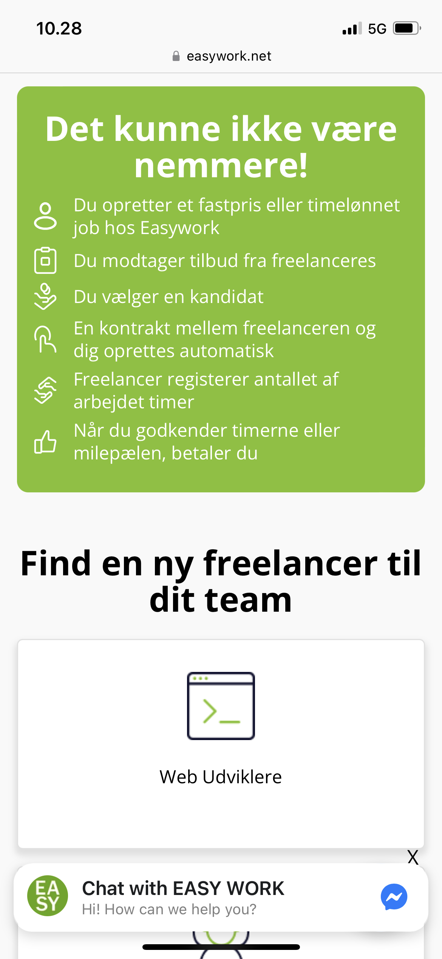



Delete text
If these 2 sections can switch order

