Slide 1
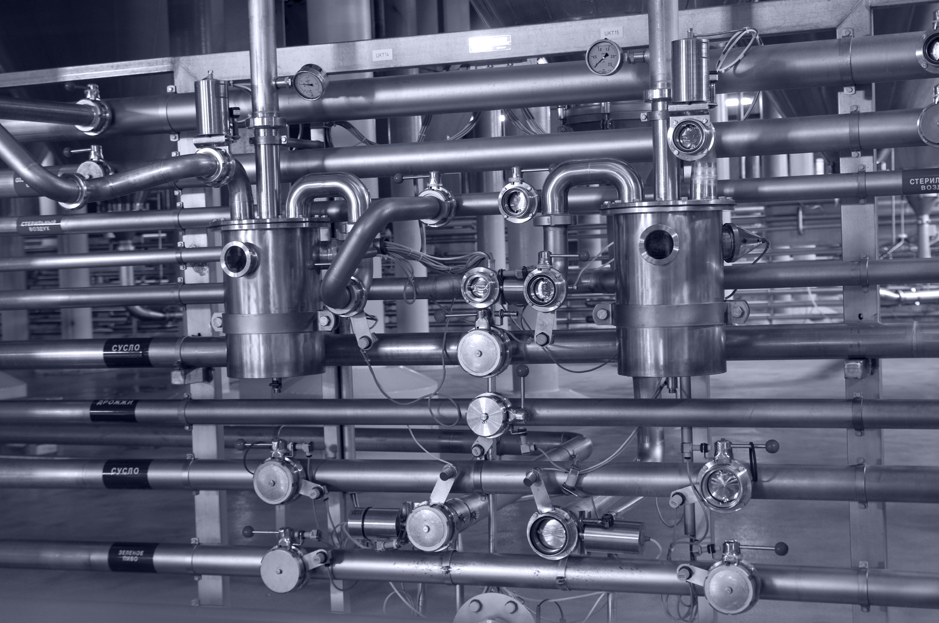
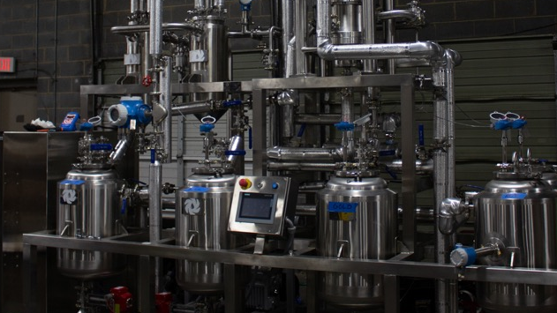

ROTAX® Ethanol Extraction System
Email: Sales@DeutscheEquipment.com
Phone: (704) 900-6606
www.DeutscheEquipment.com

Slide 2
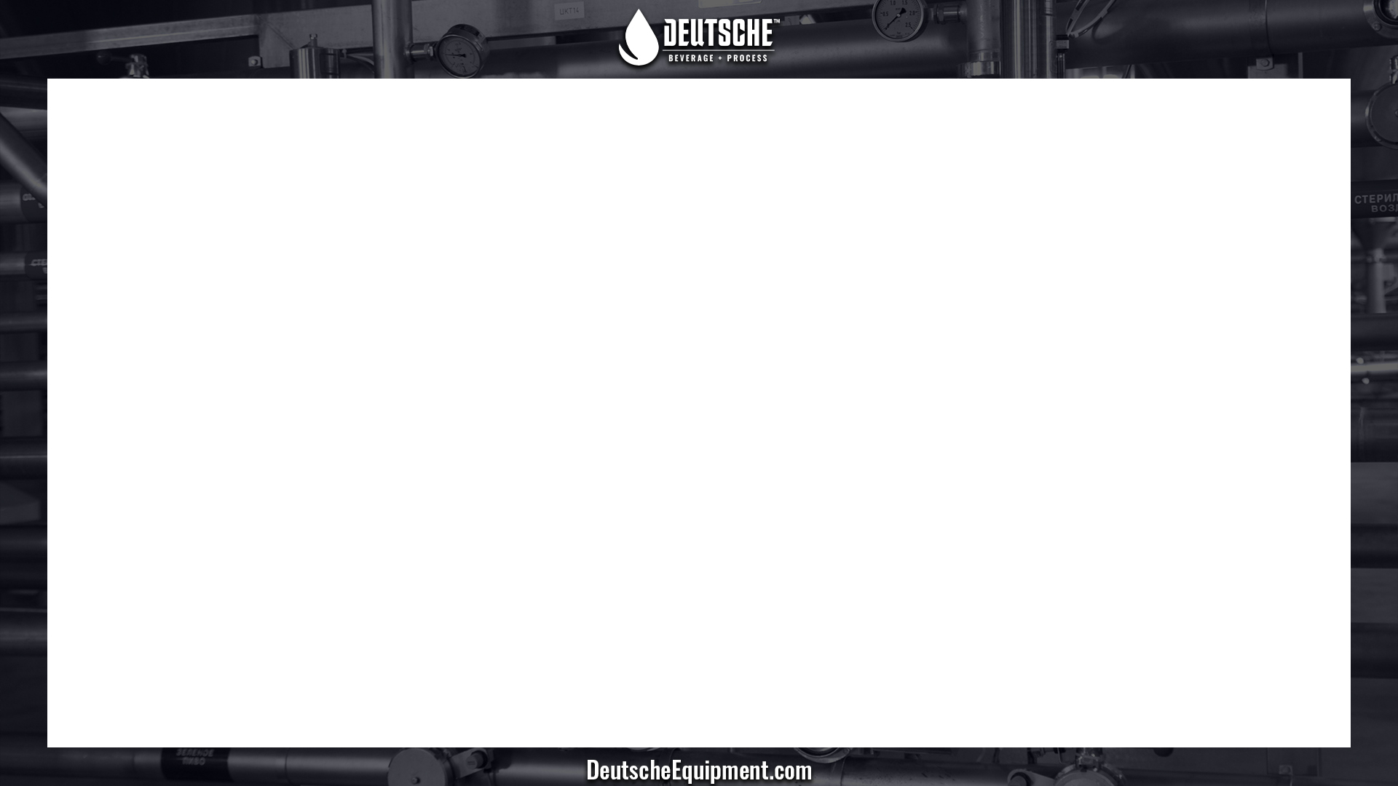
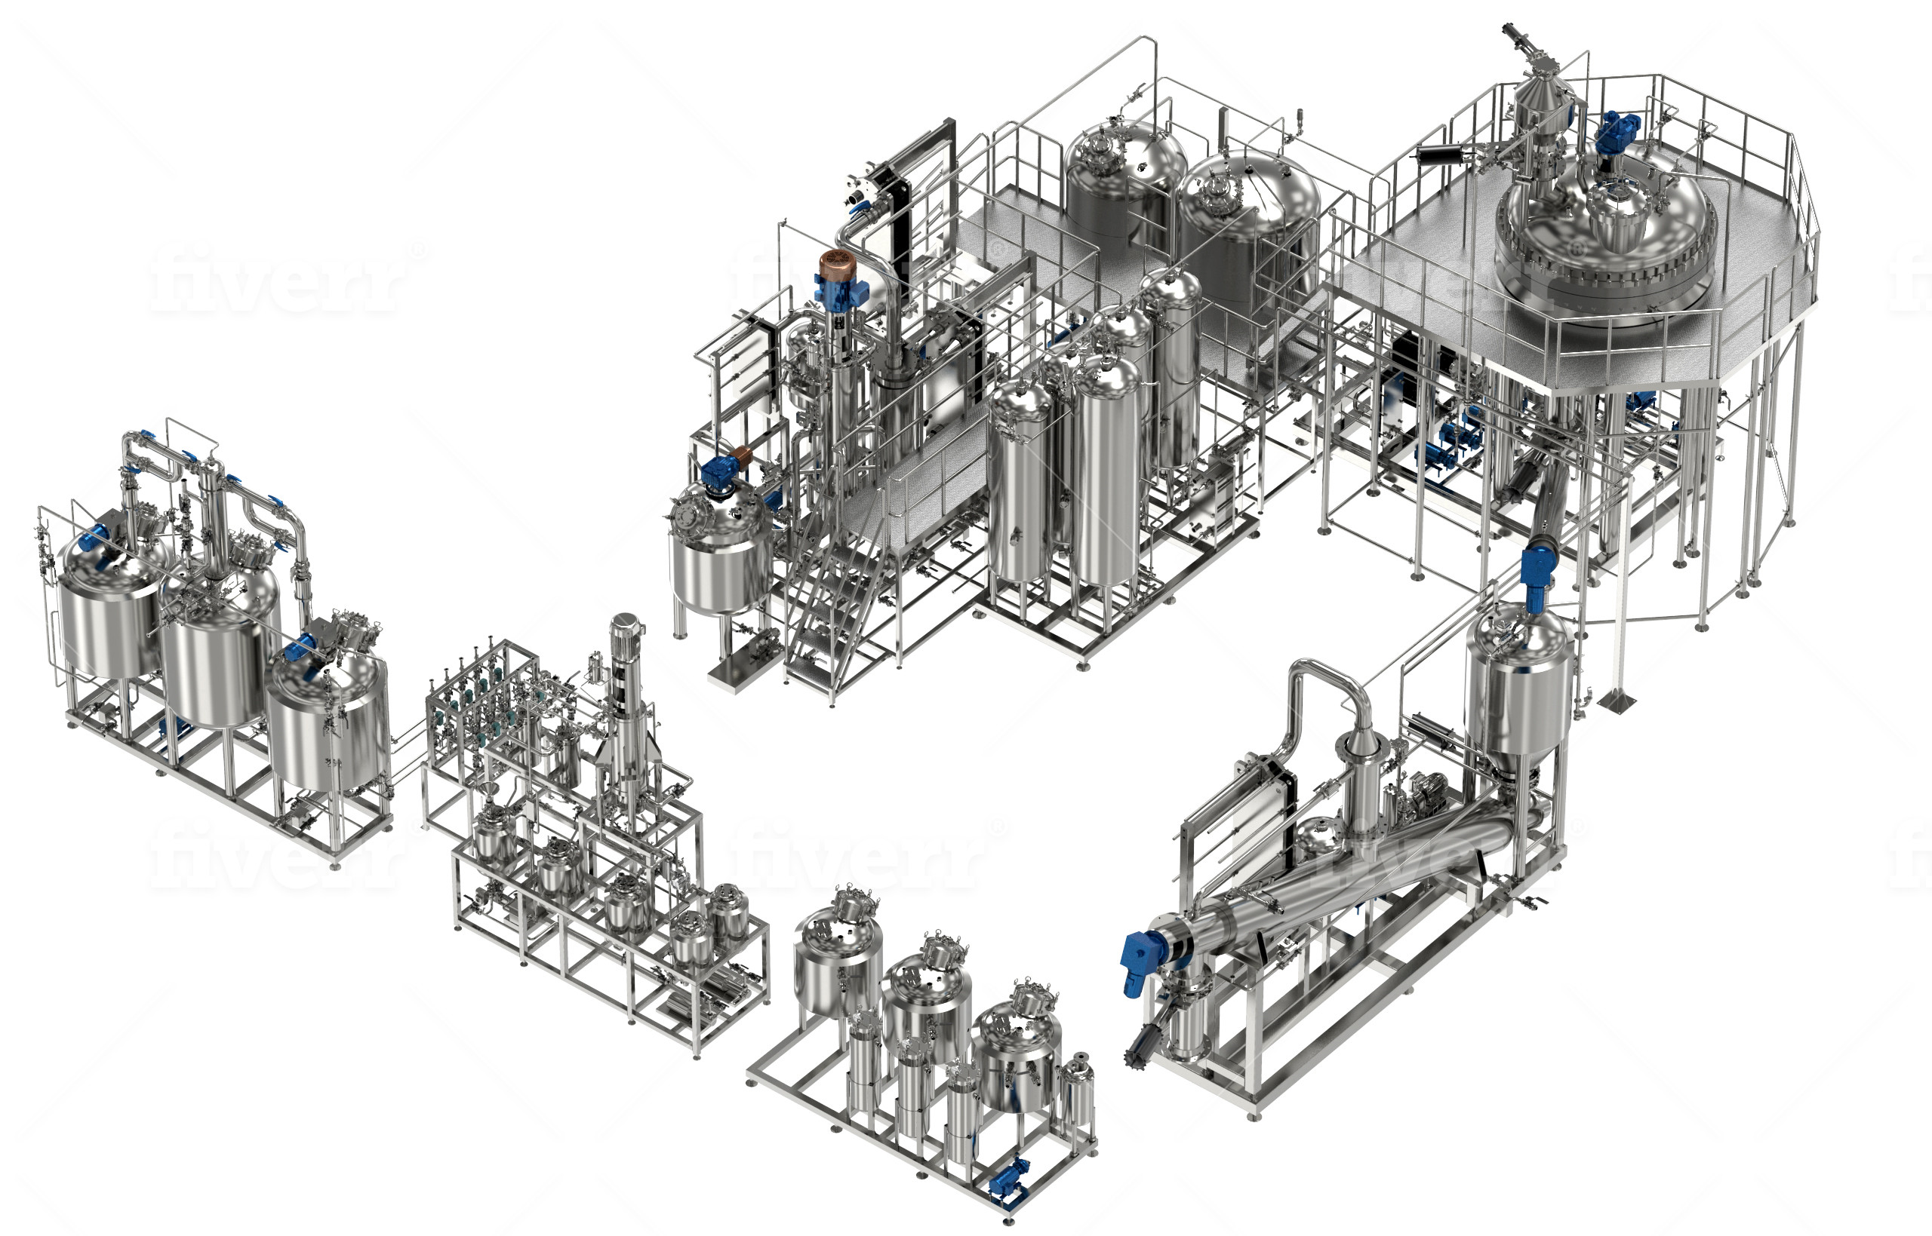
ROTAX® Continuous Extraction Plant
ROTAX Extractor
Biomass Processing and Handling
ROTAX Continuous Counter-Current Extractor
Biomass Drying Screw
RFE/WFE Oil Separation Skid
Molecular Sieve Solvent Regeneration
Crude Oil Post-Processing Options
  -Short Path Distillation Unit
  -Skidded Reaction Tanks
  -Filter Dryer
  -SKS/SCR Solvent Recovery System

Slide 3
ROTAX® Extractor Details
Continuous, Counter-Current Extraction
6 (six) extraction stages
Automated biomass input and discharge
250 lbs to 500 lbs of biomass throughput per hour
Capable of -40ºC extraction
  Post extraction winterization also available
Solvent contact time 10 to 20 minutes
Gentler extraction process compared to agitated batch extraction
Optimal solvent to feed ratios ranging from 4:1 to 8:1
Extraction yield losses ¼ to ½ of those observed for single stage batch extractors
  Eliminates decanter/screw press losses
Lower solvent to feed ratios compared to competitive batch and multi-batch extractors
  Counter current design minimizes solvent to feed ratio and maximizes yield

Slide 4
ROTAX® Continuous Counter-Current Extraction Principle

Slide 5
ROTAX® Concentration Profile, 4:1 Solvent to Feed Ratio
 |  |  |  | Out | [C], % | [C], Norm
S5 | >>> | B0 | >>> | C6 | 0.211 | 1
S4 | >>> | B1 | >>> | C5 | 0.037 | 0.175
S3 | >>> | B2 | >>> | C4 | 0.011 | 0.052
S2 | >>> | B3 | >>> | C3 | 0.006 | 0.028
S1 | >>> | B4 | >>> | C2 | 0.003 | 0.014
S0 | >>> | B5 | >>> | C1 | 0.001 | 0.004

Slide 6
ROTAX® / Batch Comparison
Normalized extraction efficiencies are comparable
ROTAX utilizes 4:1 SF ratio compared to 10:1 or greater S:F ratio in comparable batch systems
  ROTAX has 60% less post extraction solvent removal compared to competitive systems
ROTAX has no decanter/screw press losses
  In competitive systems, decanter/screw press losses are 1% to 8% depending on the SF ratio
  Decanter/screw press losses increase with decreasing SF ratio
S:F | Decanter / Screw press
Ratio | % Loss
4.00 | 7.83%
10.00 | 3.14%
40.00 | 0.79%

